Slide 1
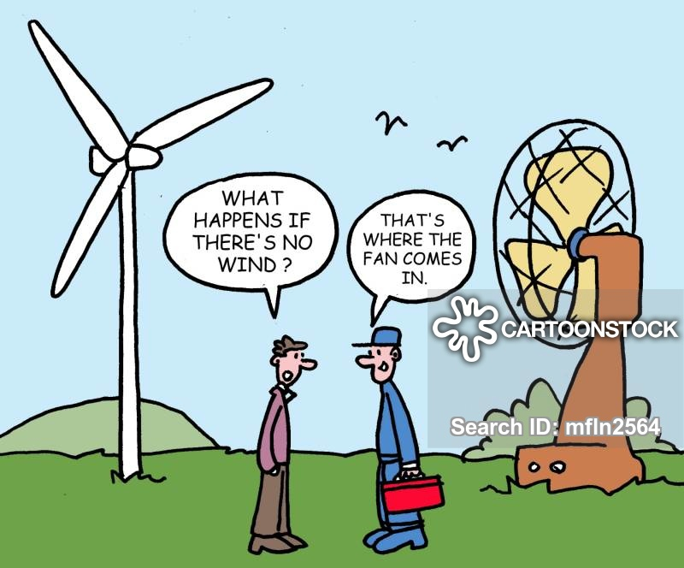
Power GuIde
Eren ÖZKARA
Büşra Nur KOÇAK
Yunus ÇAY

Slide 2
ıntroductıon
Final Topology
Simulation Results
Component Selection
Control System
PCB Design
Thermal Calculations
Utilization Bonus
Industrial Product Bonus
Cheapest Design Bonus
Thermal Simulation Bonus

Slide 3
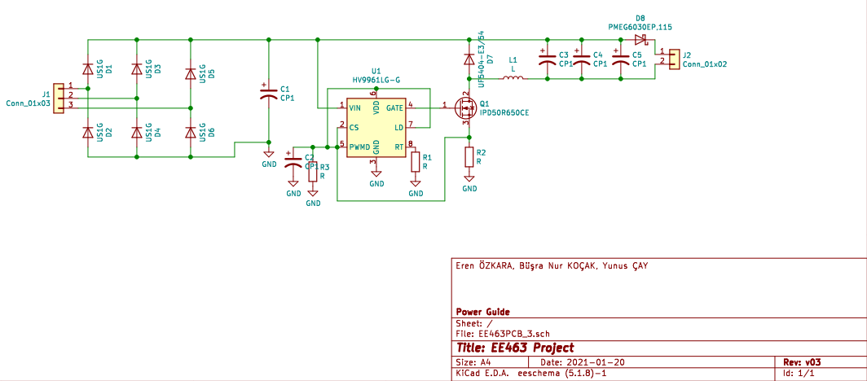
FINAL TOPOLOGY
Figure 1. Final Topology of the Project

Slide 4
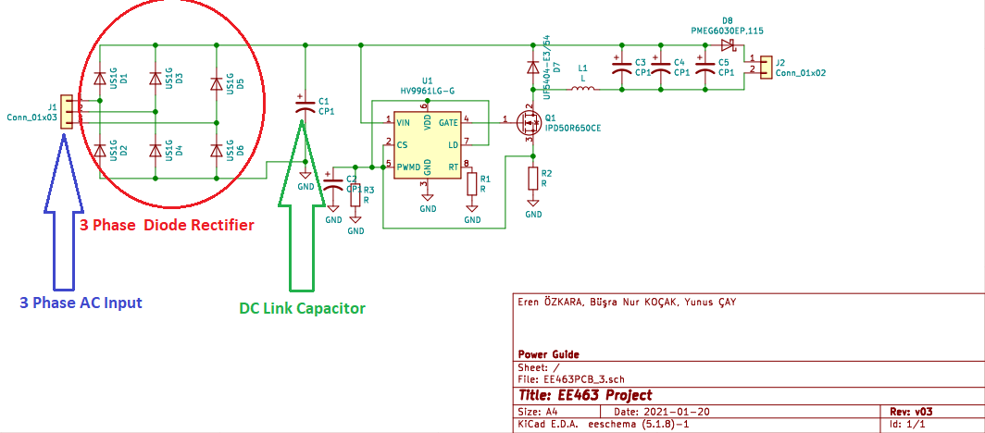
Figure 2. Rectifier Side of the Topology

Slide 5
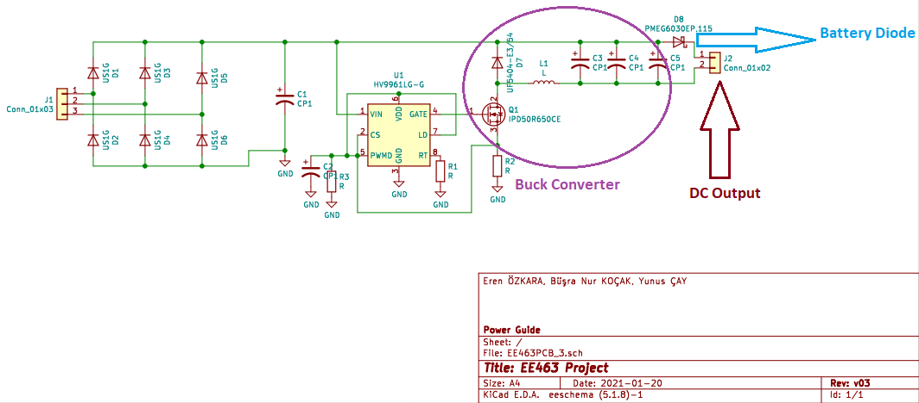
Figure 3. Buck Converter Side of the Topology

Slide 6
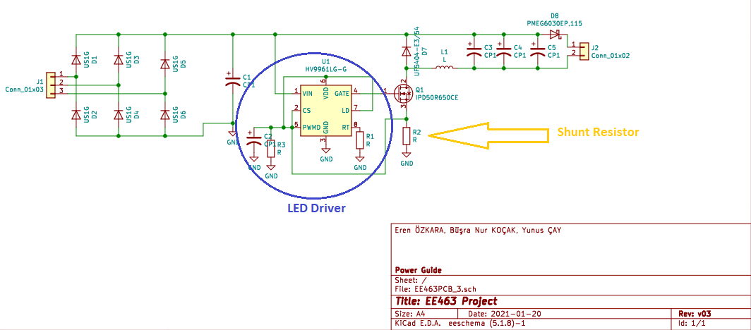
Figure 4. Controller Side of the Topology

Slide 7


Component selectıon

Slide 8
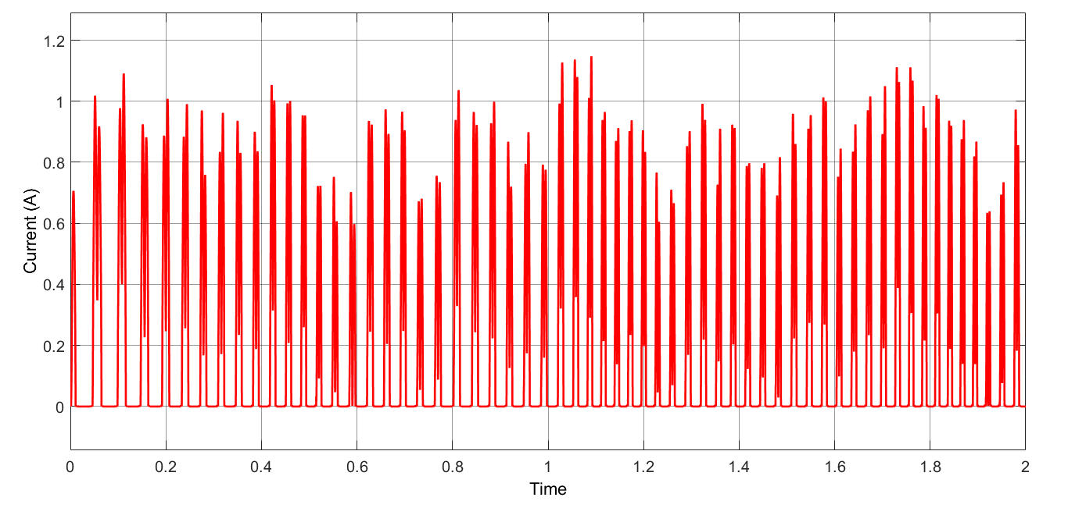
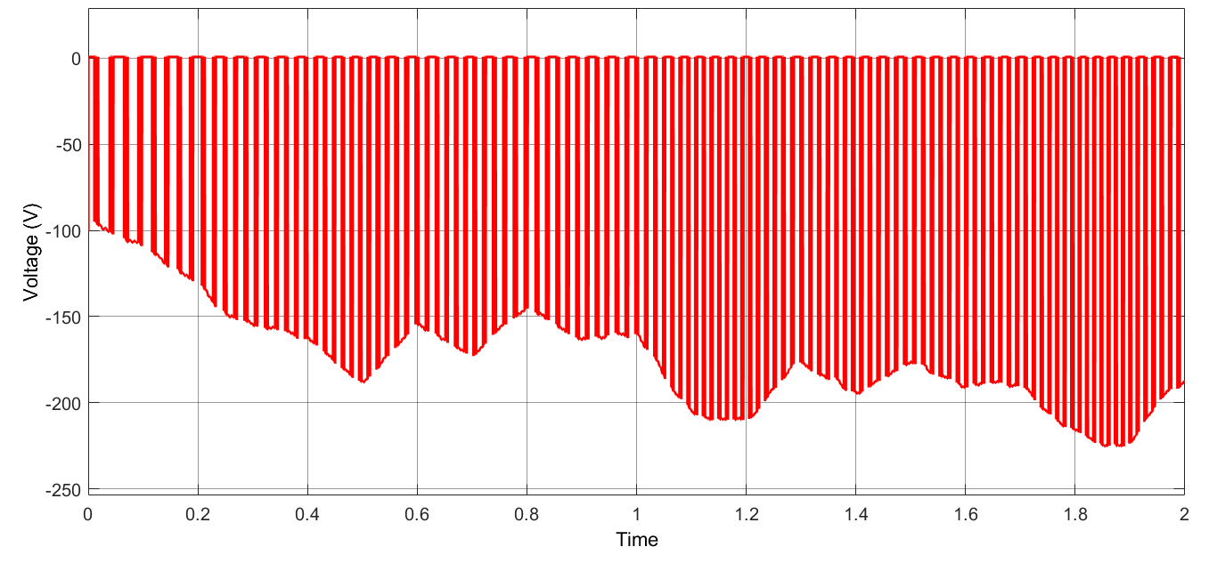
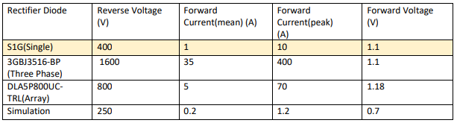
Rectıfıer dıode
Figure . Voltage and Current Waveforms of Rectifier Diode
Table . Rectifier Diode Selection Table

Slide 9
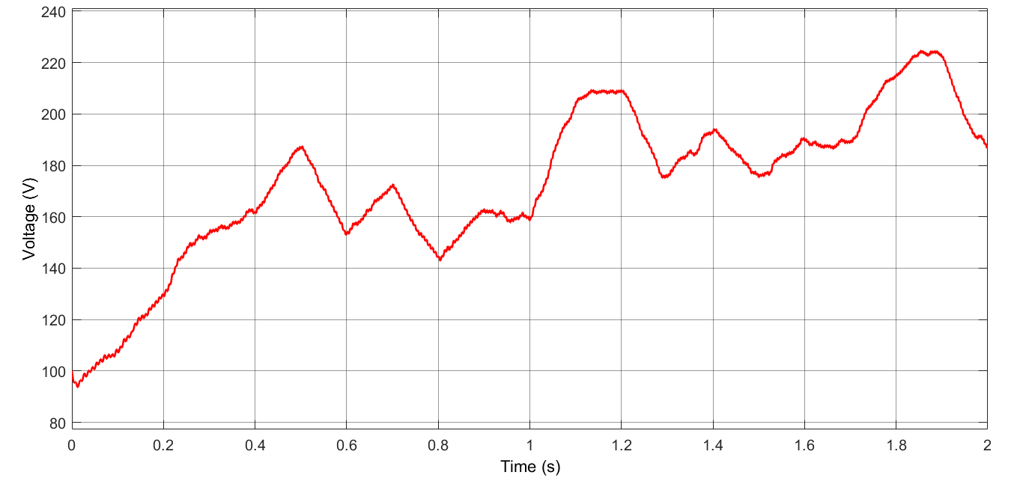
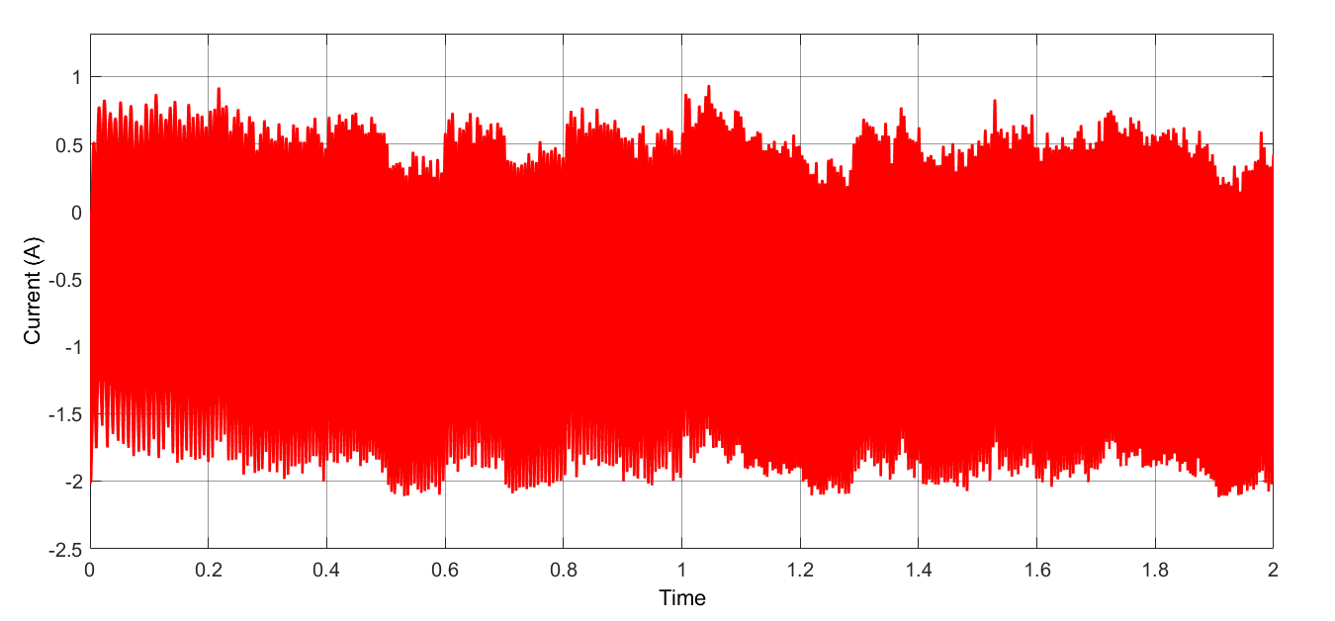
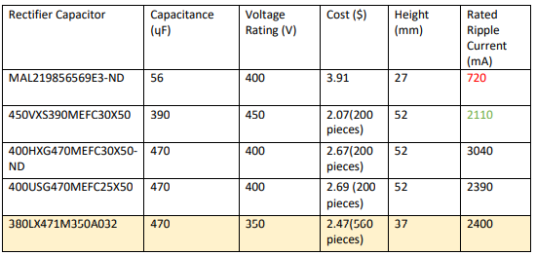
Dc lınk capacıtor
Figure . Voltage and Current Waveforms of DC Link Capacitor
Table . DC Link Capacitor Selection Table

Slide 10
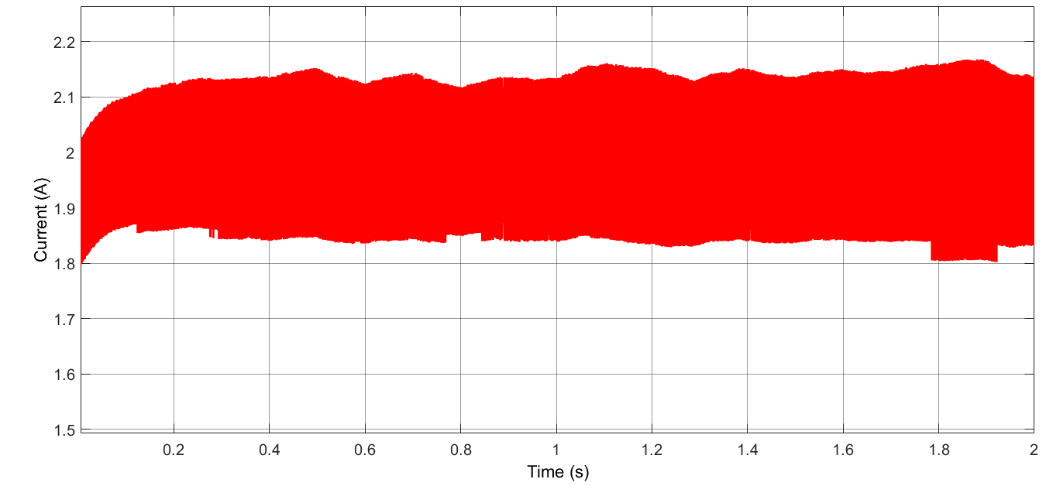
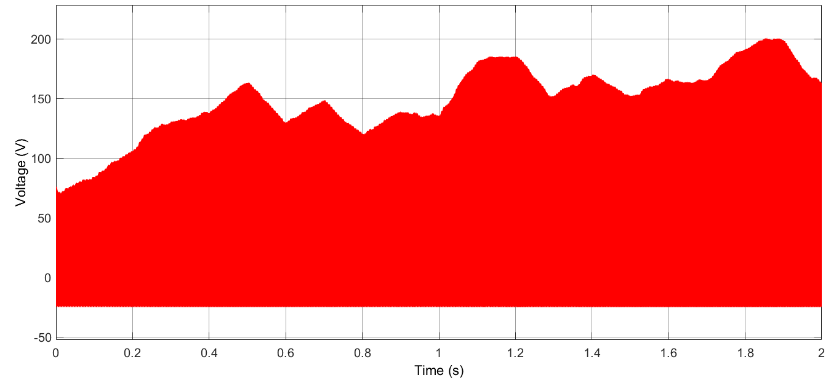
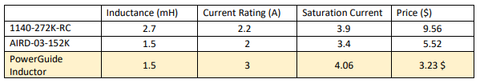
Buck converter ınductor
Figure . Voltage and Current Waveforms of Buck Converter Inductor
Table . Buck Converter Inductor Selection Table

Slide 11
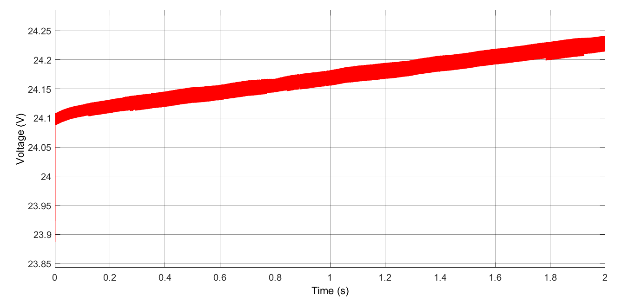
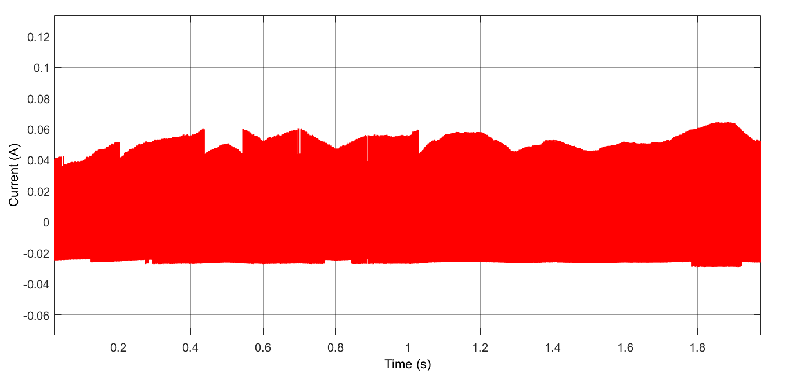
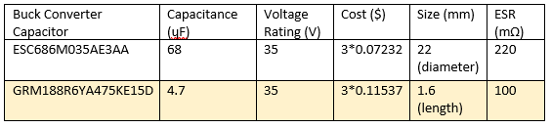
BUCK CONVERTER CAPACITOR
Figure . Voltage and Current Waveforms of Buck Converter Capacitor
Table . Buck Converter Capacitor Selection Table

Slide 12
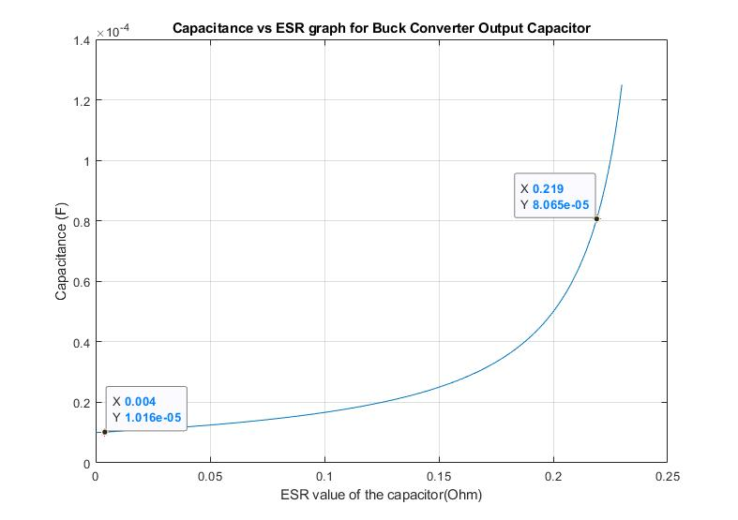
Figure . Capacitance vs ESR graph for Buck Converter Output Capacitor

Slide 13
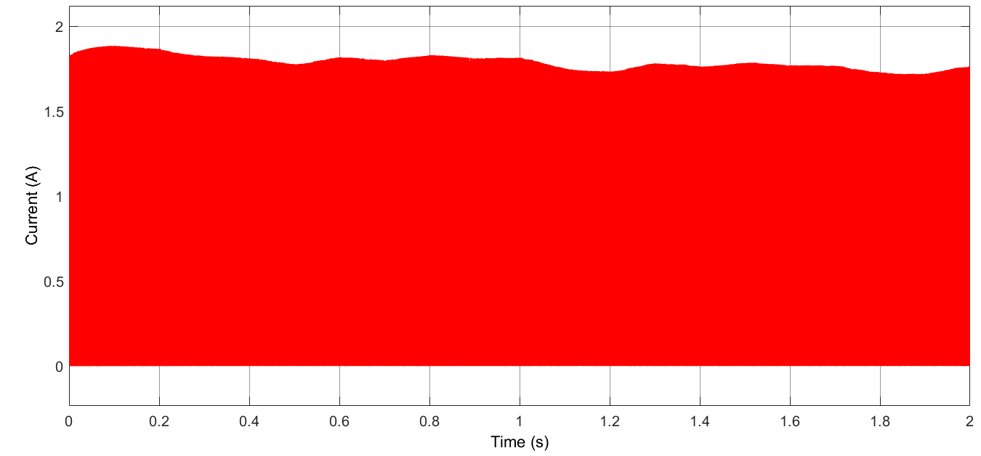
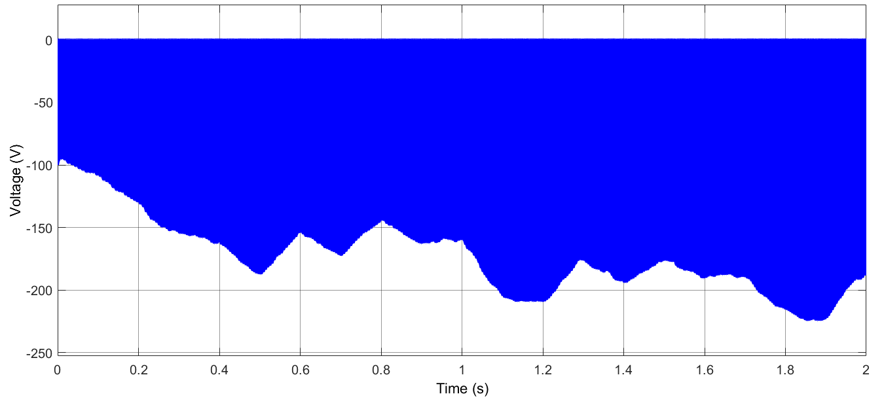
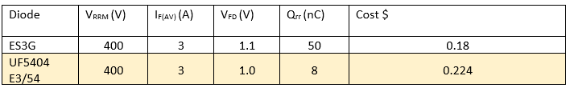
Buck Converter dıode
Figure . Voltage and Current Waveforms of Buck Converter Diode
Table . Buck Converter Diode Selection Table

Slide 14
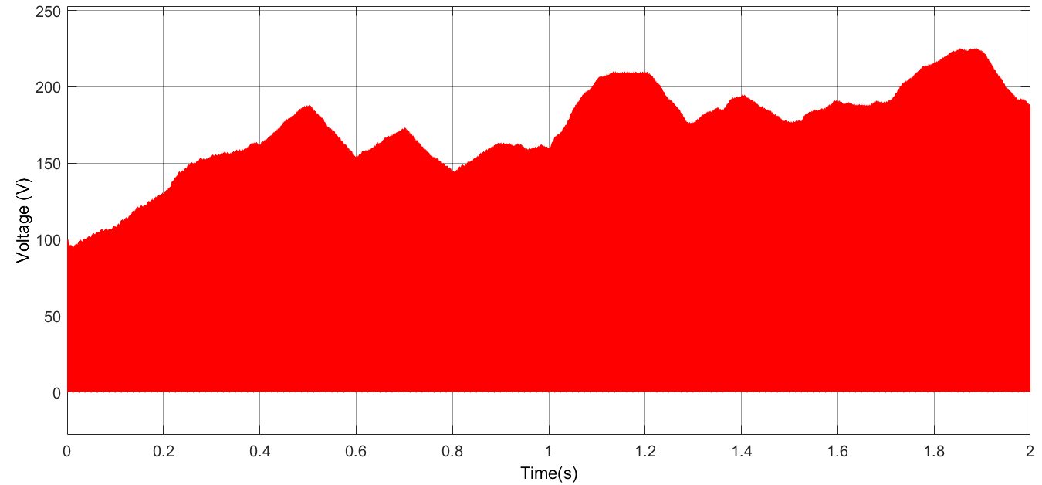
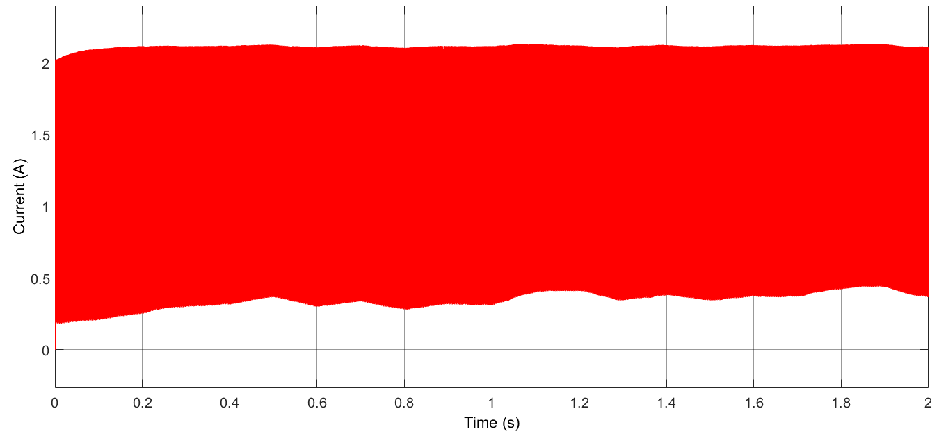
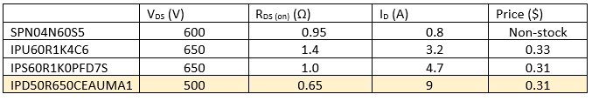
BUCK CONVERTER SWITCH
Figure . Voltage and Current Waveforms of Buck Converter MOSFET
Table . Buck Converter MOSFET Selection Table

Slide 15
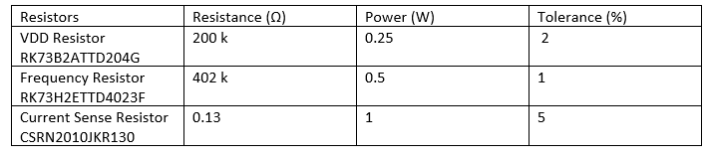

cONTROLLER
Table . Controller Selection Table

Slide 16
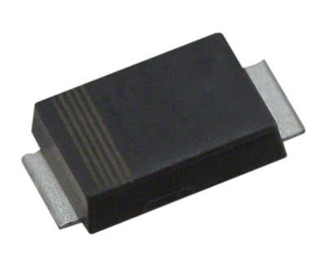

Battery dıode
Table . Battery Diode Selection Table

Slide 17
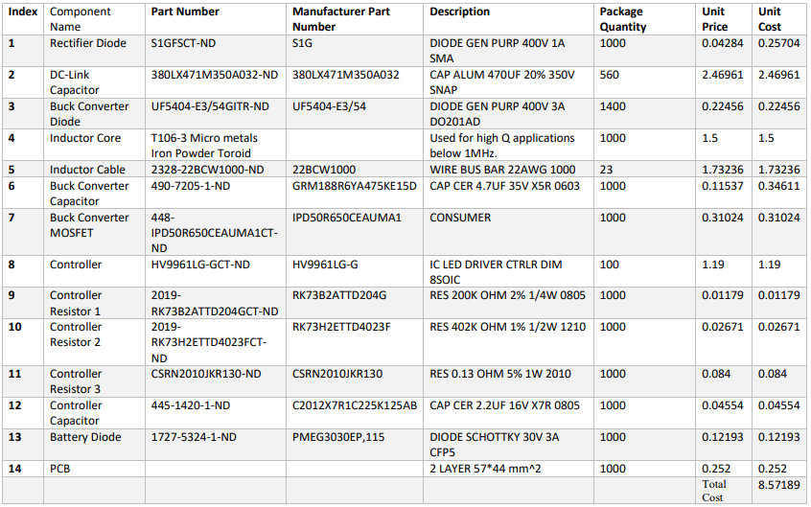
Figure . Bill of Materials

Slide 18
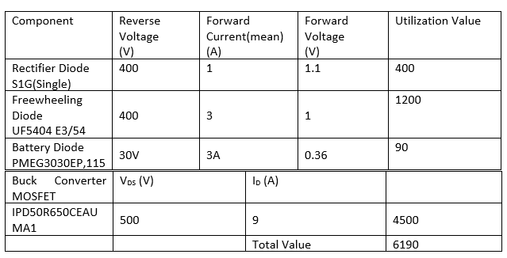
Utılızatıon bonus
Table . Utilization Bonus Table

